Slide 1

Natural Language Processing
In Banking
Lei Yu

Slide 2
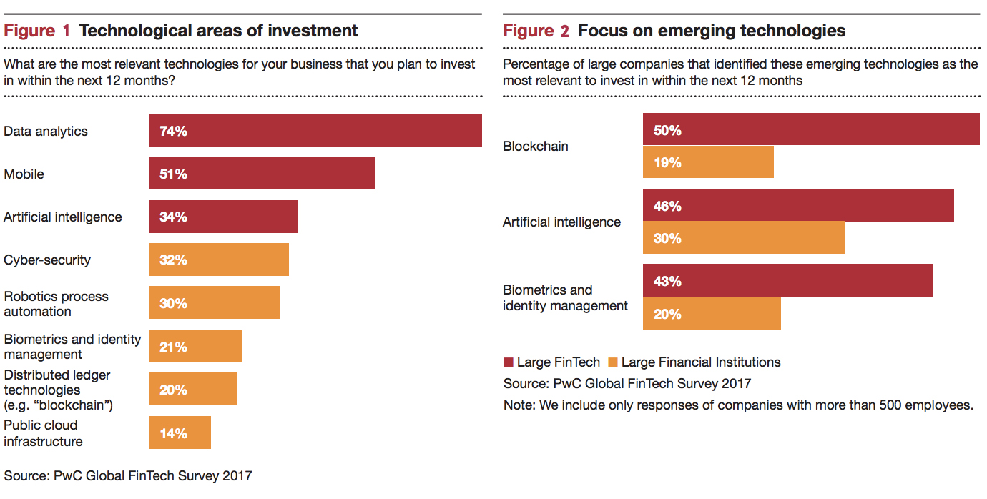
Technology in FinTech and Financial Institutions

Slide 3
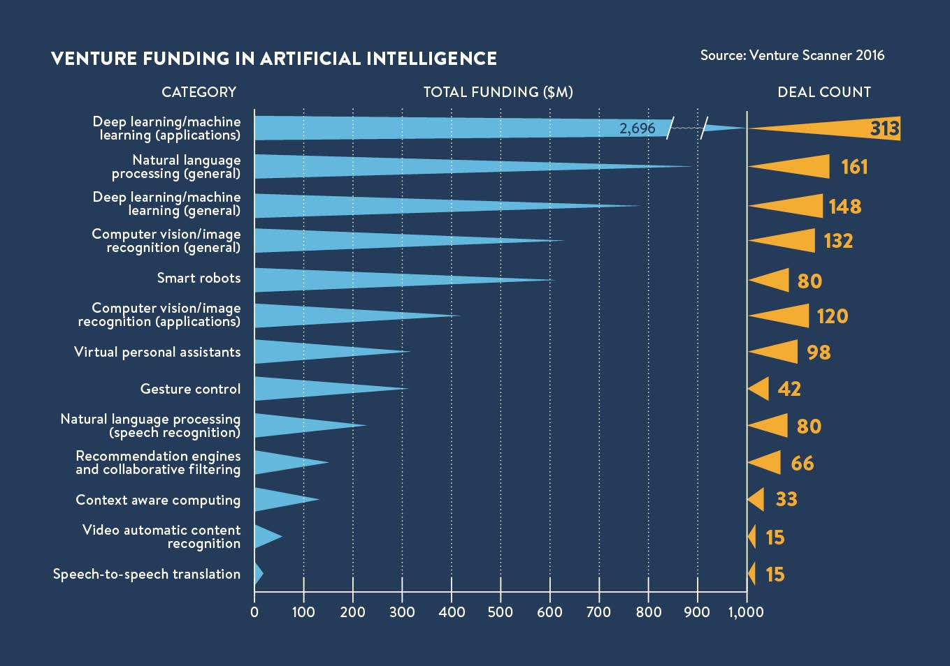

Slide 4
Here’s the things we want to talk today:
What is Natural Language Processing ?
Background
Use Cases in Banking
NLP models and Architecture
Notes:
Key Talking Points:
Gotta decide who’s gonna label data
Answer these questions first.

Slide 5
Background
What is Natural Language Processing?

Slide 6
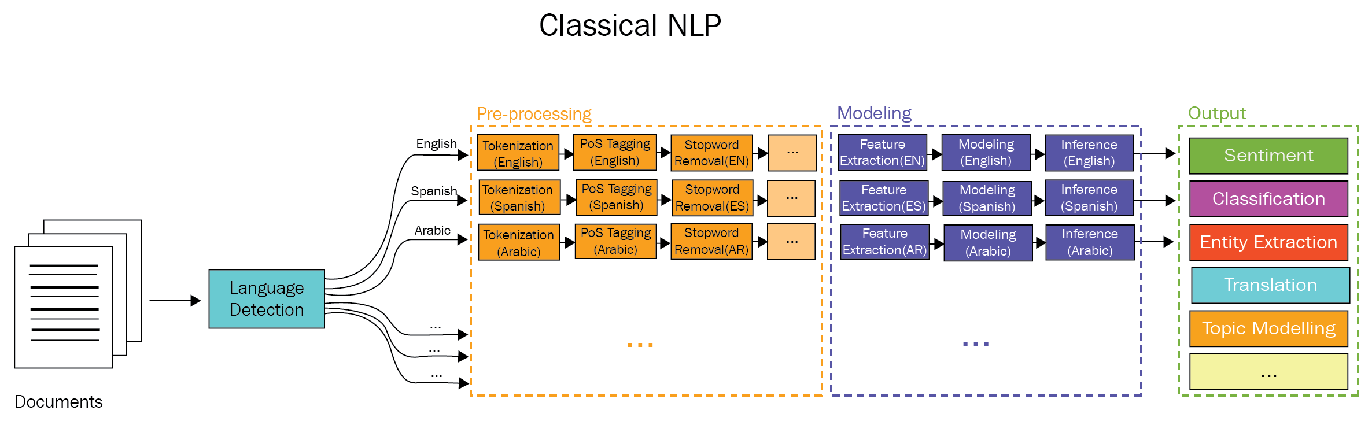
NLP

Slide 7



Use Cases
Real-Time Data Analytics and Forecasting
Natural Language Search in Database
Chatbot and Virtual Assistant
Notes:
Access Control Policies + Data Classification/Labeling: Label and Classify Data for Access based Control and Policies:
Labeled and Classified Data
Access Control
Network Traffic/Storage Encryption w/ Key Management: Generate Hashes and Unique ID’s for the Restricted Data
At-Rest Encryption
Key Management Services
Encrypted Network Traffic
Network Device Information
Hashing & Unique IDs: Deploy Third Party and Internal Agents onto the Network to Actively Scan Traffic for Labeled Data
Internal Network Traffic Scanning
Document Hashing and Matching for Outbound Data
Endpoint Scanning: Encrypt all Network Traffic and Stored Sensitive Data with proper Key Management Systems
Control Services by Role
Personal Computer and Mobile Device Level
Least-Privileged Access
Content Awareness and Monitoring with User/Group Level Policies
Scanning of external Media Devices (USB)
Active Network Traffic Scanning: Scan Endpoint Devices such as Laptop and Mobile Phones for matching Hashes and ID’s
Limitedly Permissioned Endpoints: Deploy Permission Based Access to all Endpoints, Services, and Devices starting with Least-Privilege Access

Slide 8
Real-Time Data Analytics
Every day, Reuters publishes thousands of pages of financial news
Every minute, Wall Street analysts produce several research documents
Real-Time Data and Text Analytics
Every second, financial services professionals receive emails with important financial information

Slide 9




Natural Language Search
Natural Language Search in Database

Slide 10
Conversational AI
Retrieval-Based vs. Generative Models
Long vs. Short Conversations
Open Domain vs. Closed Domain

Slide 11
Conversational AI in Banking
Don’t Need to learn how bank speak
Chatbot and Virtual Assistant

Slide 12
Conversational AI in Banking
Account balances
Available credit
Minimum payment amounts
Due dates
Transaction history

Slide 13
Conversational AI in Banking
Don’t Need to learn how bank speak
Chatbot and Virtual Assistant
Improve Customer Experience

Slide 14
Conversational AI in Banking
Chatbot understands the way you talk and loves emojis. Want to check your balance? Text “balance please,” “Bal,” or even 🤑.
Lost your card and need a replacement? Text “Replace lost card,” “Lost card,” or “Help! I can’t find my card.”

Slide 15
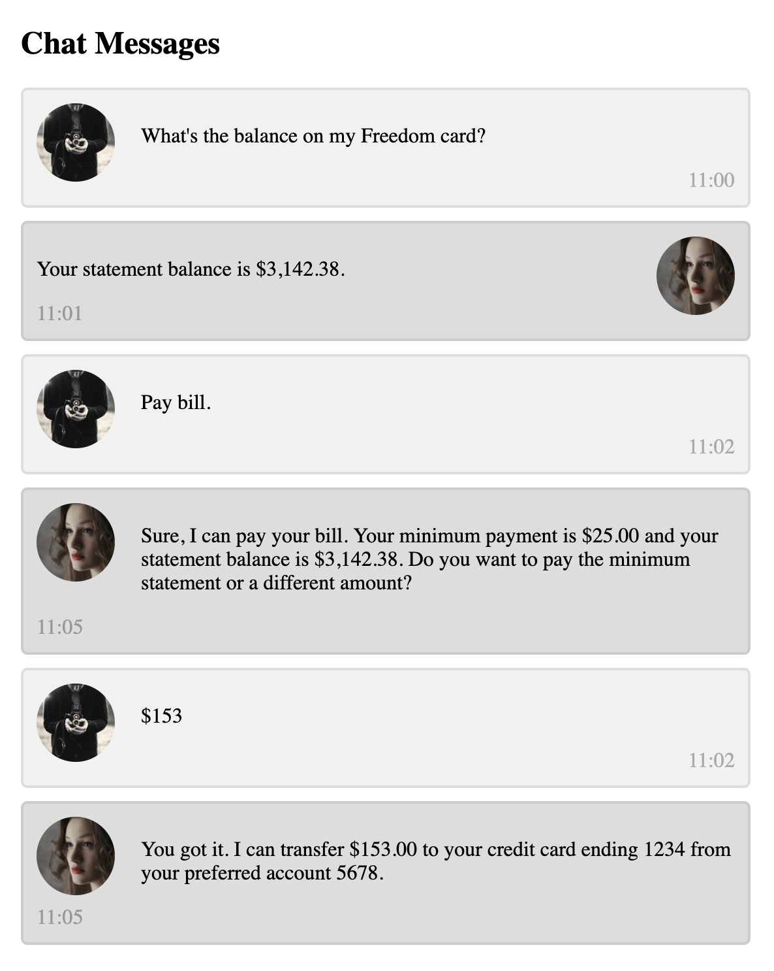

Slide 16
Intent Classification

Slide 17
Intent Classification
What’s my balance?
Give me the balance on my card.
Pay my credit card.
I’d like to make a payment.

Slide 18
Intent Classification
What’s my balance?
Give me the balance on my card.
Pay my credit card.
I’d like to make a payment.
Named Entity Recognition

Slide 19
Utterance from Customer | Intent Labeled by Human Annotator
What is my balance | Account Balance
Turn on card | Activate Card
Much appreciated | Thanks
Pay my bill | Payment
Balance for card | Account Balance
Please make my card work | Activate Card

Slide 20
Conversational AI in Banking
Don’t Need to learn how bank speak
Chatbot and Virtual Assistant
Improve Customer Experience
Information Hub and Financial Advisor

Slide 21
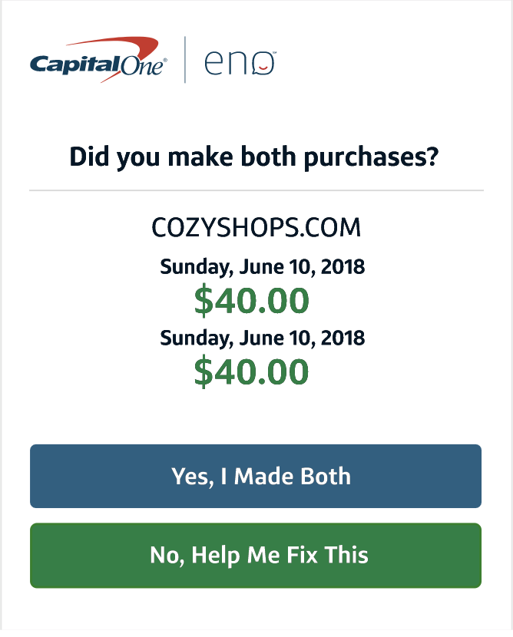
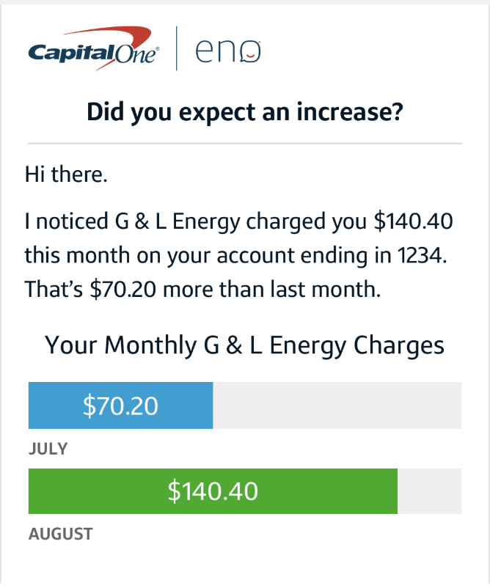
Conversational AI in Banking

Slide 22
Natural Language Processing Models

Slide 23
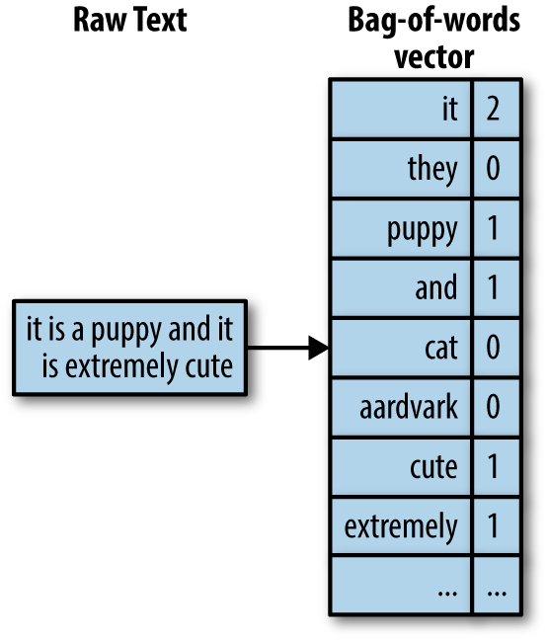
Bag of Words
Notes:
Encoders are built up of themselves
Built of rnns where the context is the hidden state
Self Attention avoids locality bias - long distance context has equal opportunity.

Slide 24

Convolutional Neural Networks
Notes:
Encoders are built up of themselves
Built of rnns where the context is the hidden state
Self Attention avoids locality bias - long distance context has equal opportunity.

Slide 25
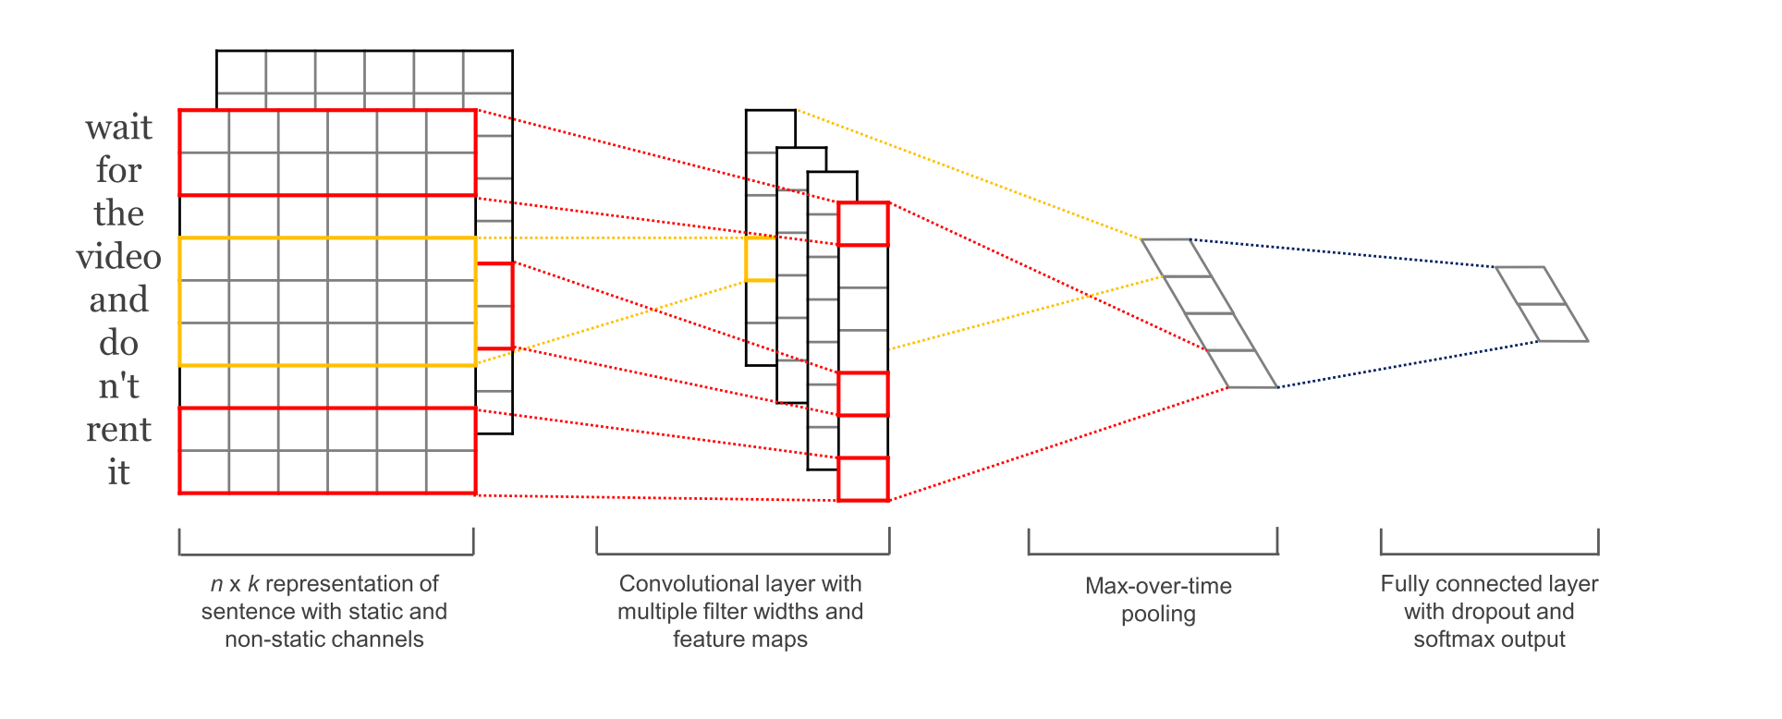
Convolutional Neural Networks
Notes:
Encoders are built up of themselves
Built of rnns where the context is the hidden state
Self Attention avoids locality bias - long distance context has equal opportunity.

Slide 26

Recurrent Neural Networks
Notes:
Encoders are built up of themselves
Built of rnns where the context is the hidden state
Self Attention avoids locality bias - long distance context has equal opportunity.

Slide 27

Long Short-Term Memory
Notes:
Encoders are built up of themselves
Built of rnns where the context is the hidden state
Self Attention avoids locality bias - long distance context has equal opportunity.

Slide 28
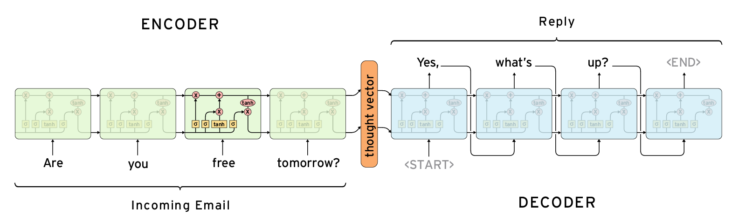
Sequence to Sequence Model
Notes:
Encoders are built up of themselves
Built of rnns where the context is the hidden state
Self Attention avoids locality bias - long distance context has equal opportunity.

Slide 29
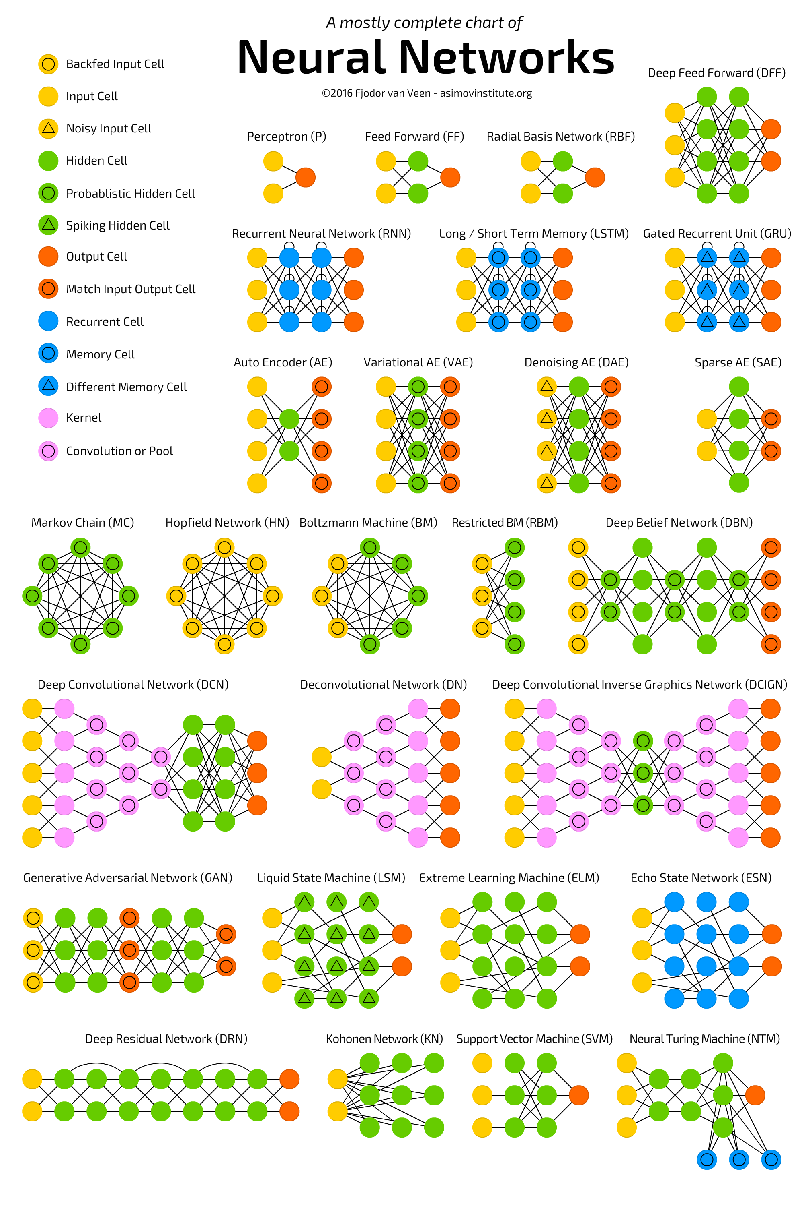

Slide 30
Architecture
Customer Utterances
Deployed Neural Nets Model
New Utterances
Neural Nets Model
Web UI
NLP Database
Neural Nets Training
Label

Slide 31
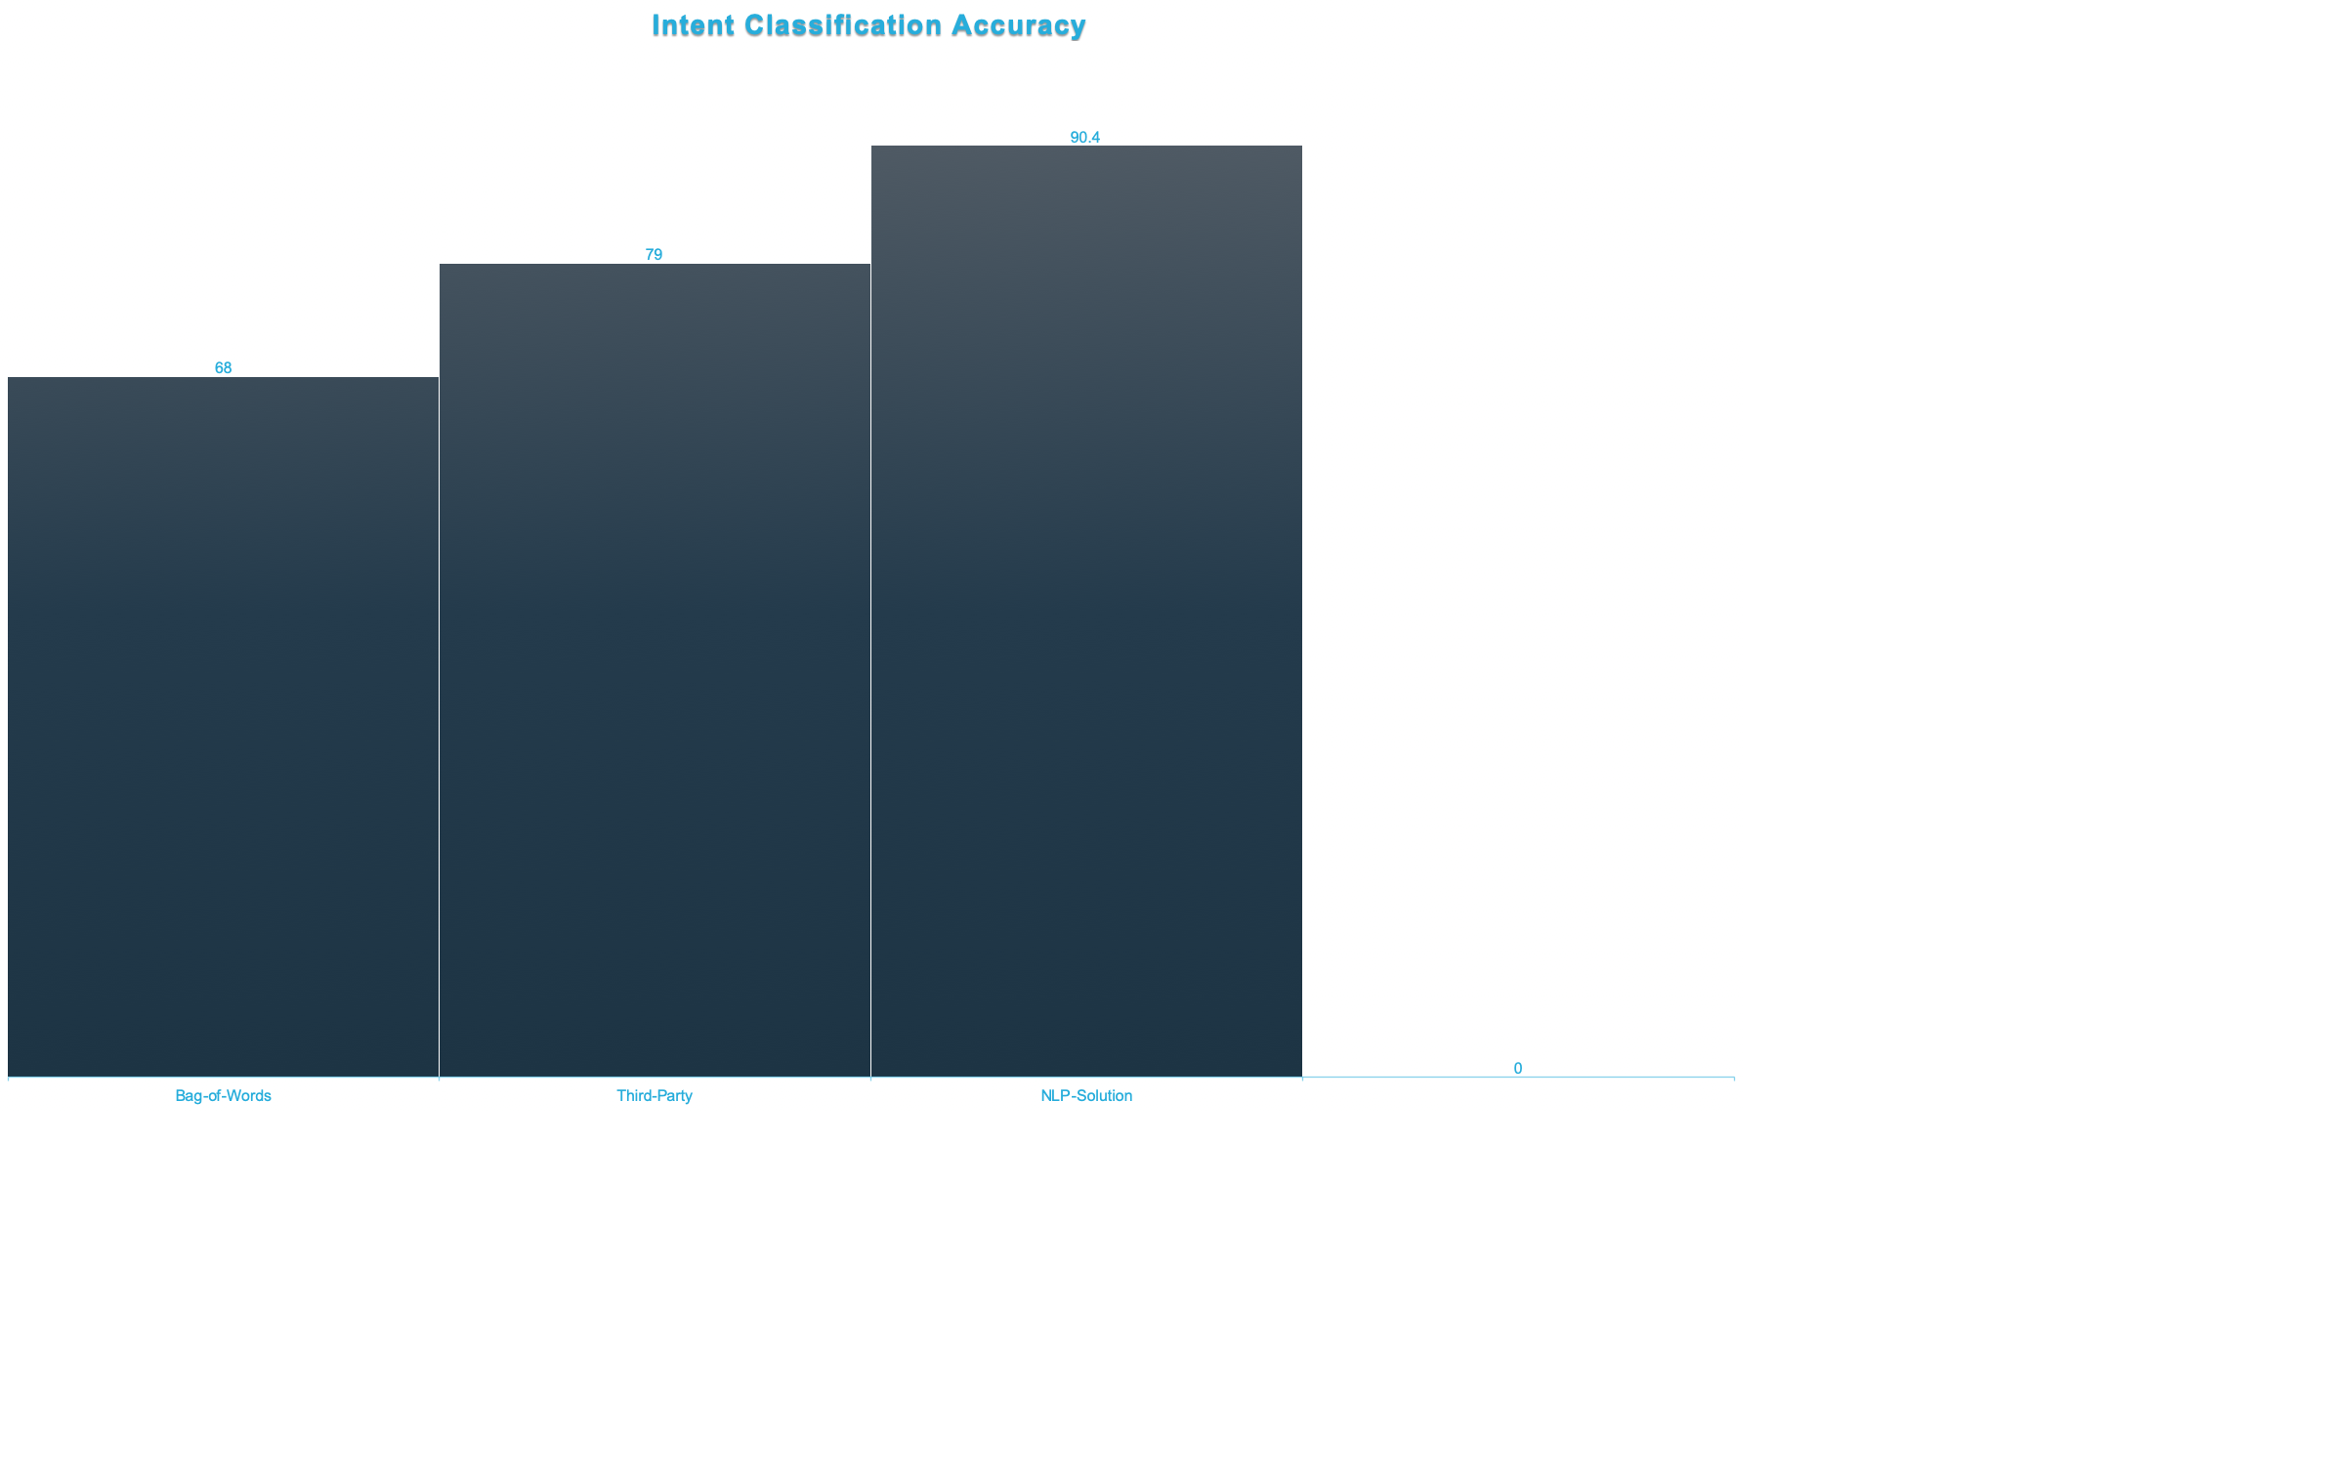

Slide 32
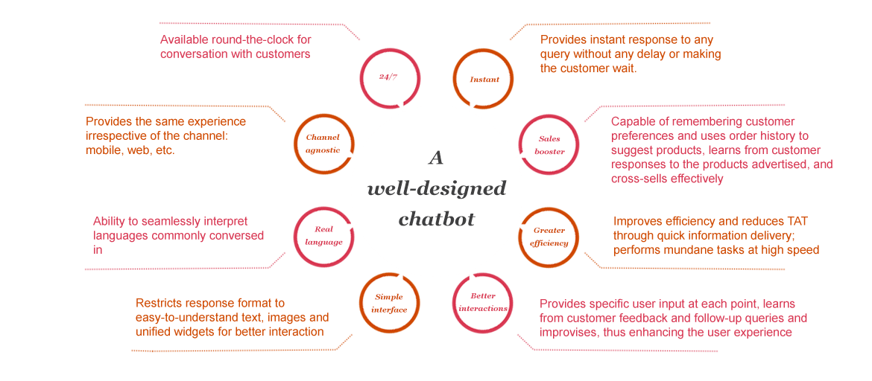
Well-Designed Chatbot

Slide 33
Lei Yu
Reach me by email:
goldin20082011@gmail.com

Slide 34
References:
[1] How can NLP technology change the finance industry:
https://friendlydata.io/blog/nlp-in-finance
[2] AI in Fintech-Current Applications and Use Cases:
https://www.proshareng.com/news/Fintech/AI-in-Fintech-%E2%80%93-Current-Applications-a/42854
[3] Chatbot: The Intelligent Banking Assistant:
https://www.pwc.in/consulting/financial-services/fintech/fintech-insights/chatbot-the-intelligent-banking-assistant.html
[4] NLP
https://fintechxpert.com/tag/nlp/
[5] Intelligent Assistant: Why we built NLP Tech in House:
https://medium.com/capital-one-tech/capital-ones-intelligent-assistant-why-we-built-eno-s-nlp-tech-in-house-8c0007c3c102
[6] 5 Common Misconceptions About Intelligent Assistants:
https://medium.com/capital-one-tech/5-common-misconceptions-about-intelligent-assistants-6a7e760cd566

Slide 35



Use Cases
Real-Time Text and Data Analytics
Natural Language Search in Database
Fraud Detection
Algorithmic Trading
Chatbot and Virtual Assistant
Cyber Security
Notes:
Access Control Policies + Data Classification/Labeling: Label and Classify Data for Access based Control and Policies:
Labeled and Classified Data
Access Control
Network Traffic/Storage Encryption w/ Key Management: Generate Hashes and Unique ID’s for the Restricted Data
At-Rest Encryption
Key Management Services
Encrypted Network Traffic
Network Device Information
Hashing & Unique IDs: Deploy Third Party and Internal Agents onto the Network to Actively Scan Traffic for Labeled Data
Internal Network Traffic Scanning
Document Hashing and Matching for Outbound Data
Endpoint Scanning: Encrypt all Network Traffic and Stored Sensitive Data with proper Key Management Systems
Control Services by Role
Personal Computer and Mobile Device Level
Least-Privileged Access
Content Awareness and Monitoring with User/Group Level Policies
Scanning of external Media Devices (USB)
Active Network Traffic Scanning: Scan Endpoint Devices such as Laptop and Mobile Phones for matching Hashes and ID’s
Limitedly Permissioned Endpoints: Deploy Permission Based Access to all Endpoints, Services, and Devices starting with Least-Privilege Access

Slide 36
Intent Classification
Named Entity Recognition

Slide 37
Intent Classification
What’s my balance?
Give me the balance on my card.
Pay my credit card.
I’d like to make a payment.
Named Entity Recognition

